Slide 1
On Sparsity and Drift for Effective Real-time Filtering in Microblogs
Date：2014/05/13
Source：CIKM’13
Advisor：Prof. Jia-Ling, Koh
Speaker：Yi-Hsuan Yeh

Slide 2
Outline
Introduction
Adaptive Filtering of Tweets
Handling Sparsity
Topic Drifting
Experiments
Conclusions

Slide 3
Introduction
Social media have grown as massive networks of information publishers and consumers. (ex: Twitter)
Consumers may have difficulties to keep up with the vast amounts of real-time information .
Publishers have no way to ensure that their content can reach their targeted audience.
Information filtering (IF) can help both publishers and consumers by ensuring that only relevant information is delivered to the right audiences.

Slide 4
Introduction
In this paper, we study the problem of real-time filtering in Twitter.
Traditional state-of-the-art news filtering techniques are not as effective when applied on tweets.
Challenge:
Sparsity
The acute sparsity issue in filtering tweets is a unique challenge caused by the shortness of tweets.
Drift
Different aspects (subtopics) of the original topic that become more popular over time,
Certain events that occurred and drifted the topics into new aspects.

Slide 5
Introduction
We devise a solution by building on an effective news filtering technique that is based on the text classification approach of Incremental Rocchio.
Solution:
Sparsity
Use a query expansion (QE) approach to enrich the representation of the user's profile (the explicit relevant judgments of the user) during the filtering process.
Drift
Modify the classifier such that it recognizes short-term interests (emerging subtopics).
Balances between the importance of short-term interests and the long-term interests in the overall topic.

Slide 6
Outline
Introduction
Adaptive Filtering of Tweets
Incremental Ricchio
Regularised Logistic Regression
Handling Sparsity
Topic Drifting
Experiments
Conclusions

Slide 7
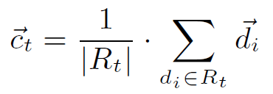
Adaptive Filtering of Tweets
Incremental Rocchio (RC)
Topic :
Football World Cup
Profile tweets $R_{t}$
New tweets
New tweets
User judged
relevant
Term vector $\overset{⃑}{d}$:
< 0.4,0.15,0, 0.2, 0.25 >
If $Sim\left({\overset{⃑}{c}}_{t},\overset{⃑}{d}\right)>η_{R}$,
then display to user.
Profile term vector
${\overset{⃑}{c}}_{t} (centroid)$ :
<0.5,0.2,0, 0.1, 0.2>
update
$R_{t}$ : the set of profile tweets

Slide 8
Adaptive Filtering of Tweets
Regularised Logistic Regression (LR)
A regular regression model
Training data: user profile tweets
Once the regression coefficients($\overset{⃑}{w}$) are estimated, the filtering prediction can be made for each incoming tweet $\overset{⃑}{x}$ by calculating the posterior probability$p(y|\overset{⃑}{x},\overset{⃑}{w})$.
If $p\left(y=1 | \overset{⃑}{x},\overset{⃑}{w}\right)>η_{L}$, then display to the user.
Profile tweets
New tweets
Update $\overset{⃑}{w}$

Slide 9
Outline
Introduction
Adaptive Filtering of Tweets
Handling Sparsity
Topic Drifting
Experiments
Conclusions

Slide 10
Handling Sparsity
Use a query expansion (QE) approach to enrich the representation of the user's profile .
New tweets
10:00 am
Timeline
Topic :
Football World Cup
Tweets that are search result of “Football World Cup.”
Pseudo-relevant tweets
Use the Kullback Leibler weighting model
Weighted: ${term}_{3}(0.4),{term}_{5}(0.3), {term}_{1}(0.15), {term}_{4}(0.1),{term}_{2}(0.05)$
…

Slide 11
Outline
Introduction
Adaptive Filtering of Tweets
Handling Sparsity
Topic Drifting
Experiments
Conclusions

Slide 12
Topic Drifting
Our idea is to dynamically change the centroid over time by introducing a decay factor that balances between short-term and long-term interests.
Long-term interests → The overall topic.
Ex: Football World Cup
Short-term interests → Emerging subtopics.
Ex: player, goal
$L_{t}$ : the set of all the relevant tweets so far representing the long term interests in the overall topic, i.e $L_{t}=R_{t}$
$S_{t}$ : the set of the most recent relevant tweets representing the short term interests.

Slide 13
Topic Drifting
Arbitrary adjustment : the most n recent tweets add to $R_{t}$.
Profile tweets $R_{t}$
n = 3
Daily adjustment : $the tweets in R_{t}$ that have been add in the current calendar day.
Profile tweets $R_{t}$
Tweet that post in the current calendar day

Slide 14
Topic Drifting
Event detection
9:10 am
9:20 am
9:30 am
9:40 am
9:50 am
10:00 am
10:10 am
Timeline
$S_{t}$
Step 1 : Use DFReekLIM weighting model to score individual tweets for a topic.
Step 2 : Use CompSUM voting technique to estimate the final score of the tweets set.
Step 3 : Use Grubb’s test to determines if the tweeting rate about the topic at the current time is an outlier.

Slide 15
Outline
Introduction
Adaptive Filtering of Tweets
Handling Sparsity
Topic Drifting
Experiments
Conclusions

Slide 16
Experiments
Tweet 2011 Jan 23 to Feb 8
10561763 tweets
Use Dirichlet language model for weighting the terms in the vector.
h1: tweets that do not contain at least one query term are not considered for similarity computation and are regarded as irrelevant.
h2: tweets that contain at least one term in either the query or the first positive example.
Precision, recall, F_0.5, T11SU

Slide 17
Experiments

Slide 18
Experiments

Slide 19
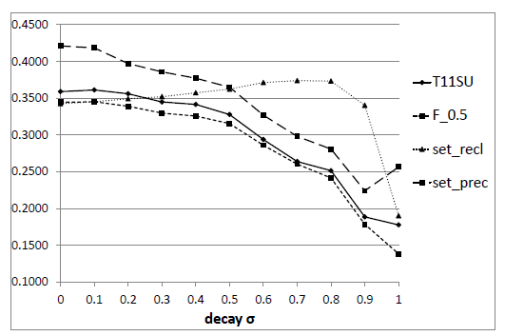
Experiments

Slide 20
Outline
Introduction
Adaptive Filtering of Tweets
Handling Sparsity
Topic Drifting
Experiments
Conclusions

Slide 21
Conclusion
In this paper, we approach the problem of real-time filtering in the Twitter Microblogging platform.
To tackle the acute sparsity problem, we apply query expansion to derive terms or related tweets for a richer initialisation of the user interests within the profile.
To deal with drift, we modify the user profile to balance between the importance of the short-term interests, i.e. emerging subtopics, and the long-term interests in the overall topic.

